Slide 1
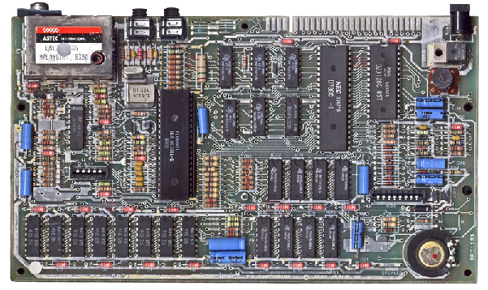
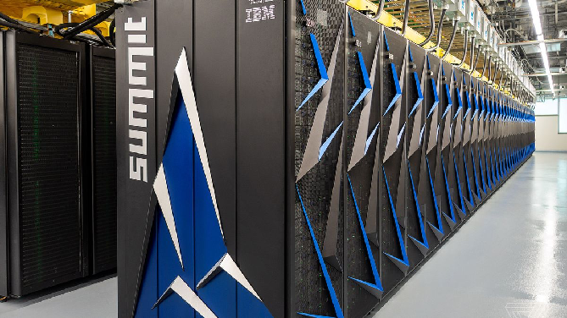
ENGR 151
An (accelerated) introduction to computers and programming
Lecture 4 - MATLAB: Data Visualization and Analysis and Project 1 Overview

Slide 2
Recap
Array indexing
Use index or range of indices (:) directly
Create an array of indices
Logical variables and logical indexing
Extract/modify elements from the matrix that corresponds to the positions with a ‘true’ value
Matlab (implicit) typecasting
Demotes interaction between integer and double

Slide 3
Contents
Project 1 brief
Data visualization in 1D
Data visualization in 2D
RGB images

Slide 4
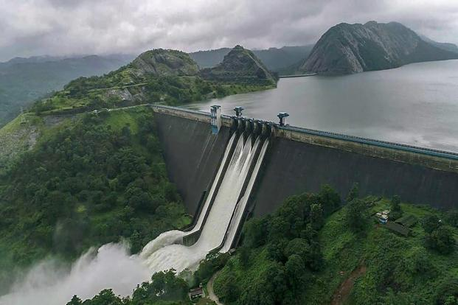
Project 1: Design a Dam
Array operations, functional programming, visualization
The Idukki Dam in Kerala. Photo credit: PTI

Slide 5
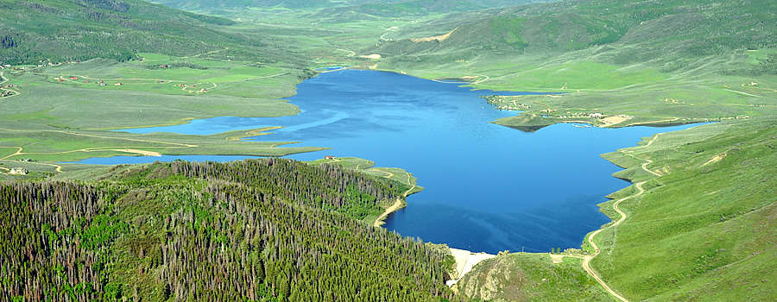
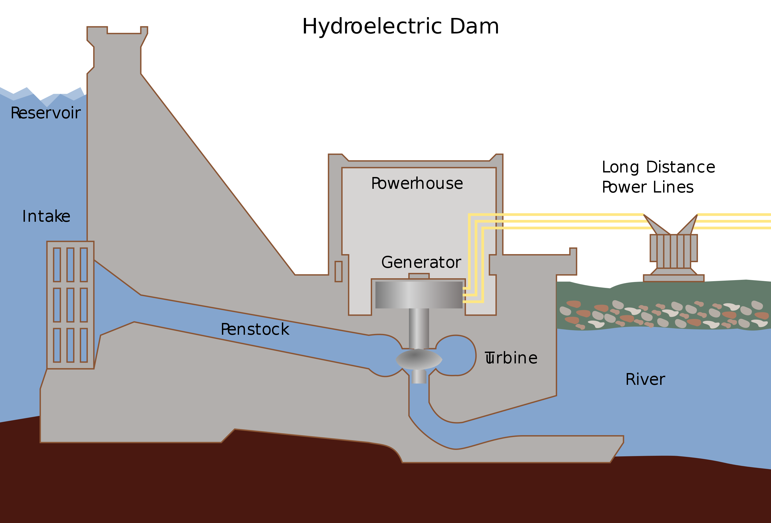
Dams and hydroelectric power
Dams are barriers that restrict water flow
They produce reservoirs of water for human use
They may be used to generate hydroelectric power, which is a clean source of energy
They may result in destruction of environment or heritage sites and displacement of people
http://www.upperyampawater.com
Wikipedia

Slide 6
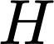
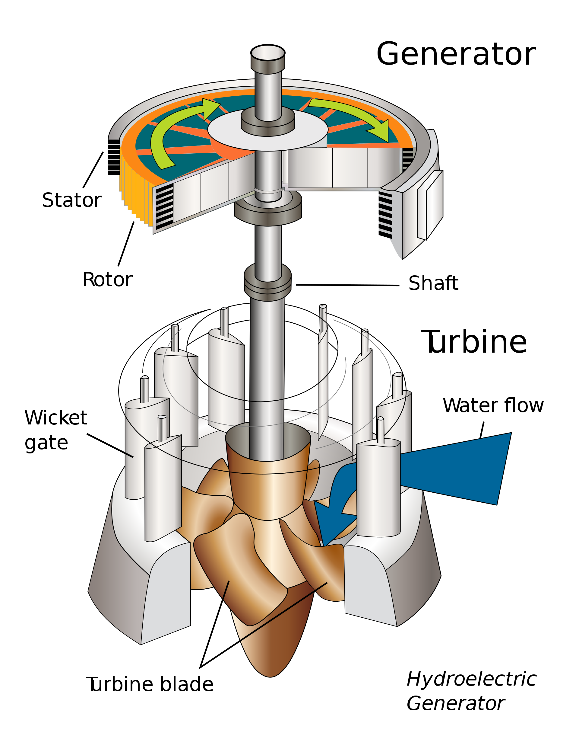
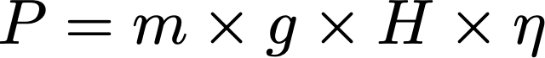
Hydroelectric power
Electricity is generated by a turbine blade driven by water flow
Can estimate power from water mass flow (i.e. kg of water flowing through system per second), height of drop, and built in efficiencies by
where g = 9.81 ms⁻¹ is the earth’s gravitational acceleration, H is the effective drop the water experiences (head) and $η$ is the net efficiency of all components
Wikipedia
Notes:
Gravitational potential energy

Slide 7
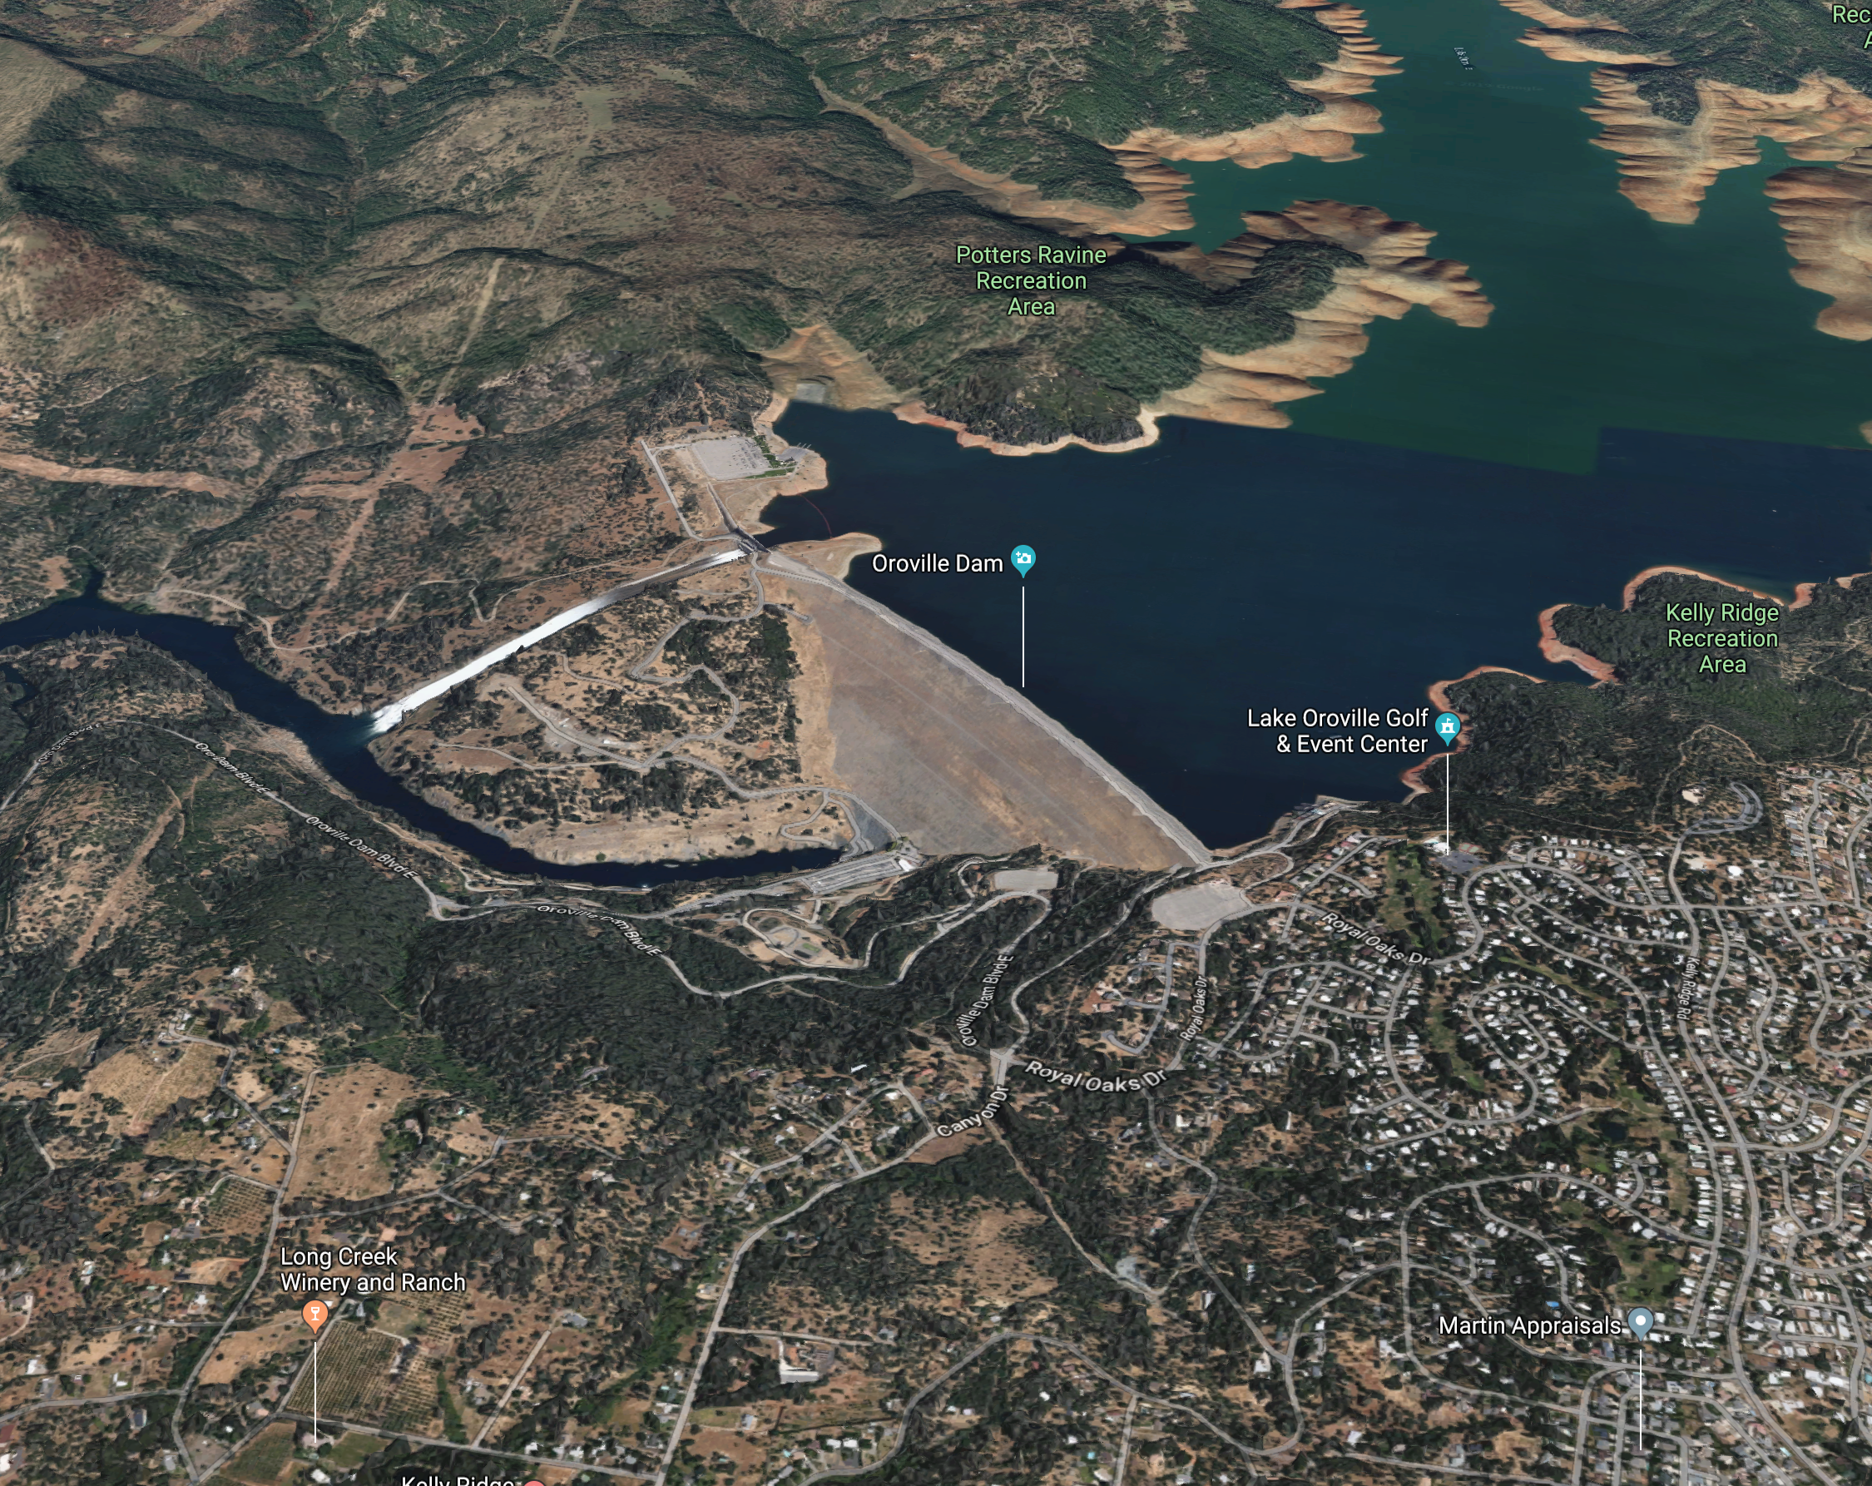
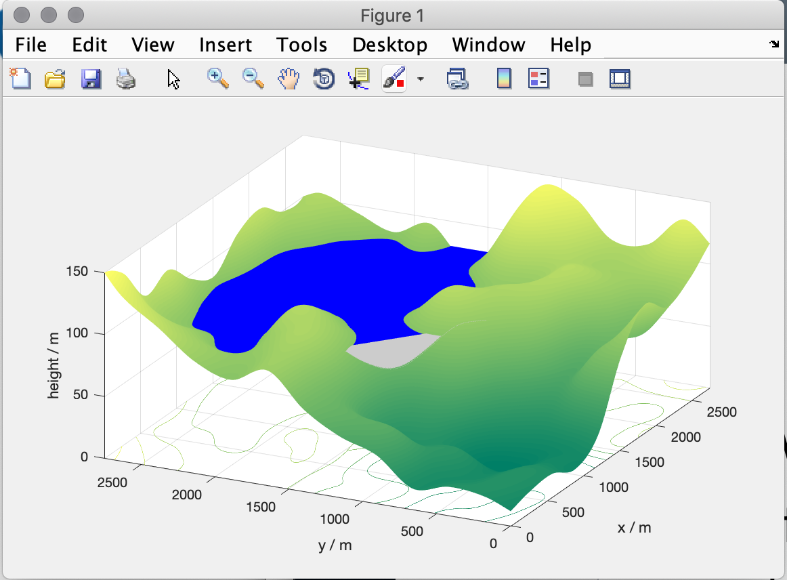
Tasks
Write a function to calculate maximum power generated for given efficiency, dam height and mass flow rate
Visualize water reservoir using a surface plot of landscape and water surface — take into account dam position
Write a function that finds the volume of water in reservoir for a given height of the water surface
googlemaps
valley
Due by Sept. 22
Notes:
12: 10?

Slide 8
Contents
Project 1 brief
Data visualization in 1D
Data visualization in 2D
RGB images

Slide 9
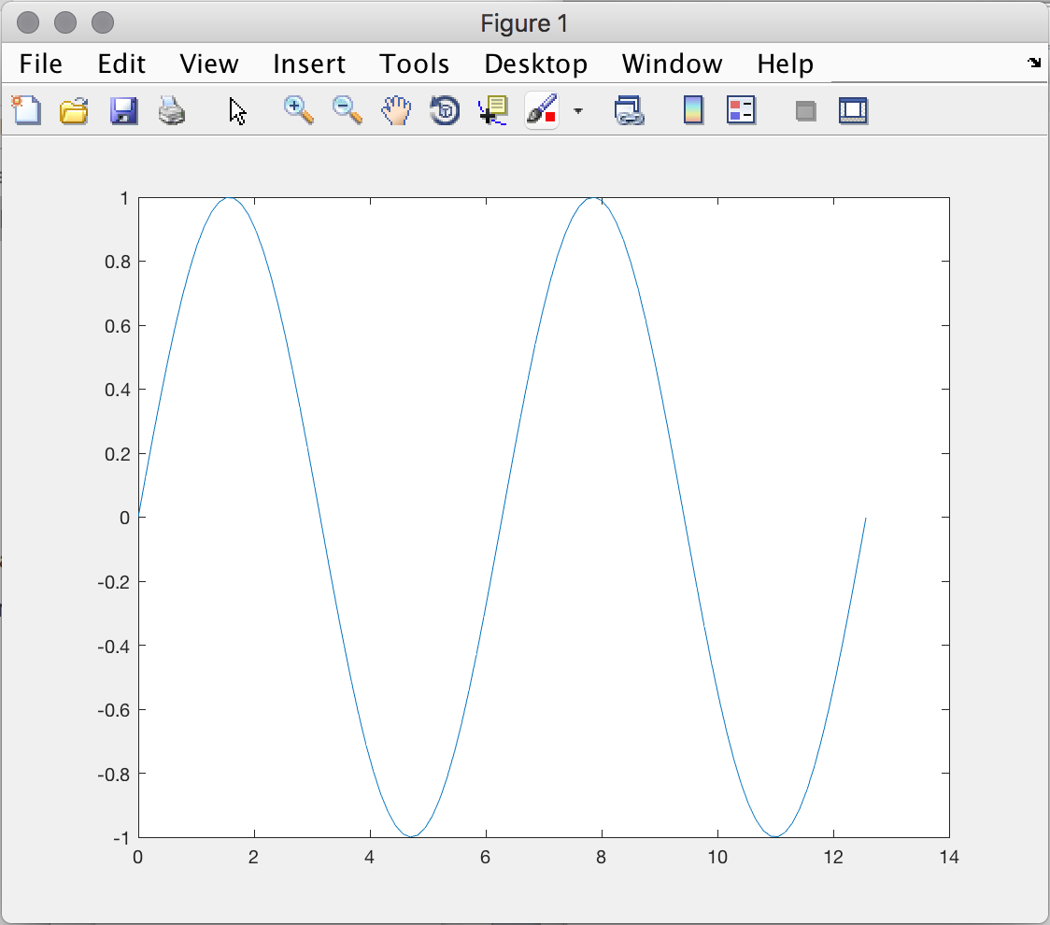
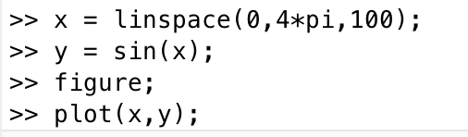
Line plots
plot gives a graph of a dependent variable (y) as a function of a parameter (x) plot(X,Y)
plot(X,Y,LineSpec)
Notes:
X and Y must be 1-D arrays with the same size.
LineSpec (specified line style, marker or color)
Must be (x,y) coordinates
Steps: 1. Create the x grid (linear spacing)
2. Calculate y values (vectorized function)
3. Call function to plot

Slide 10
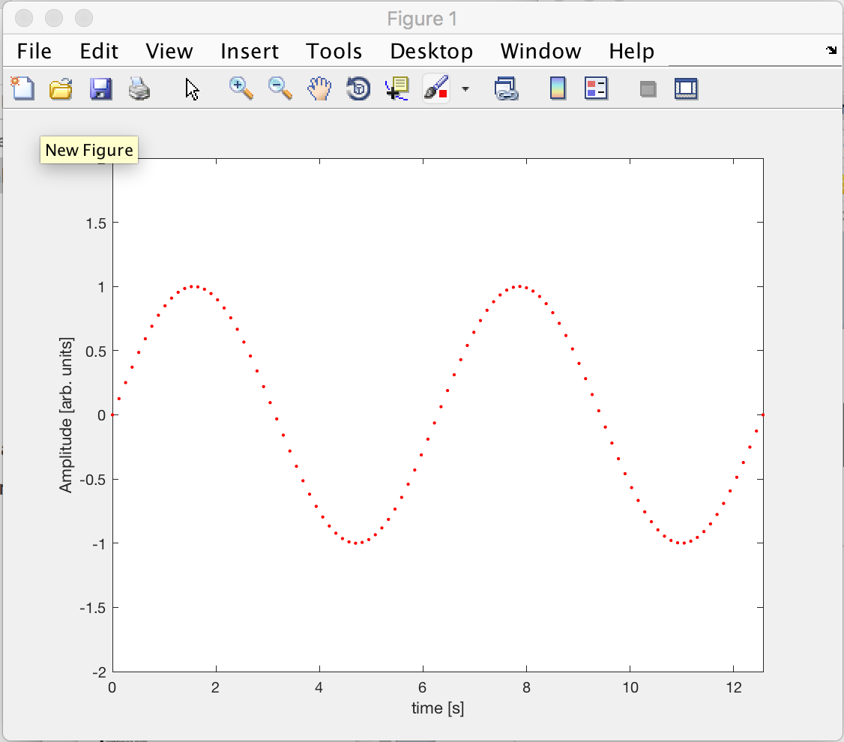
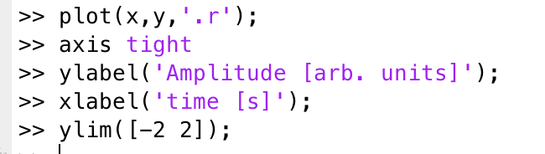
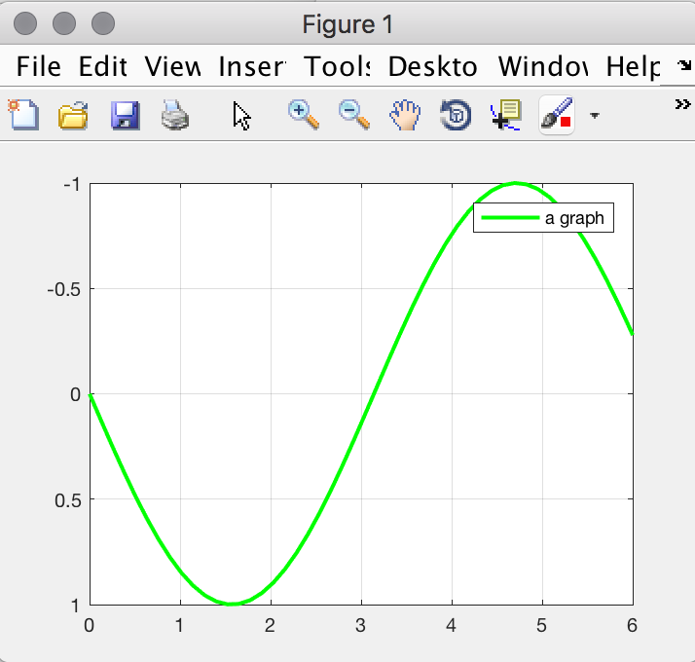
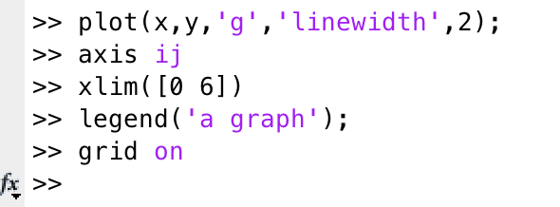
Graph formatting
Can control appearance of graph using huge range of options
Notes:
.r
axis tight: sets the axis limits to the range of the data
Dont need to talk axis ij: i-axis with values increasing from top to bottom

Slide 11
Line Specifiers
Use a line specifier to distinguish among multiple curves in the same plot, or otherwise achieve preferred style
Basic form: plot(x, y, lineSpec)
lineSpec: a string with codes for various options
color marker style line style
y = yellow . = point o = circle - = solid
m = magenta x = x-mark + = plus : = dotted
c = cyan s = square d = diamond -. = dash-dot
r = red * = star p = pentagram -- = dashed
g = green h = hexagram
b = blue v = triangle down
w = white ^ = triangle up
k = black > = triangle right
< = triangle left

Slide 12
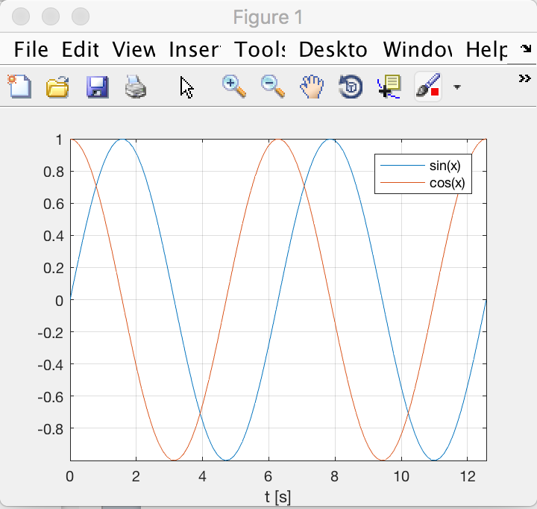
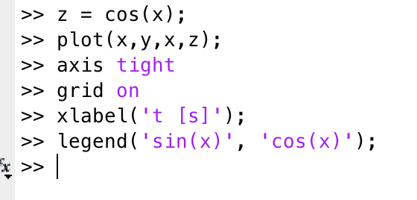
multiple curves on same plot
Notes:
demo another curve to previous

Slide 13
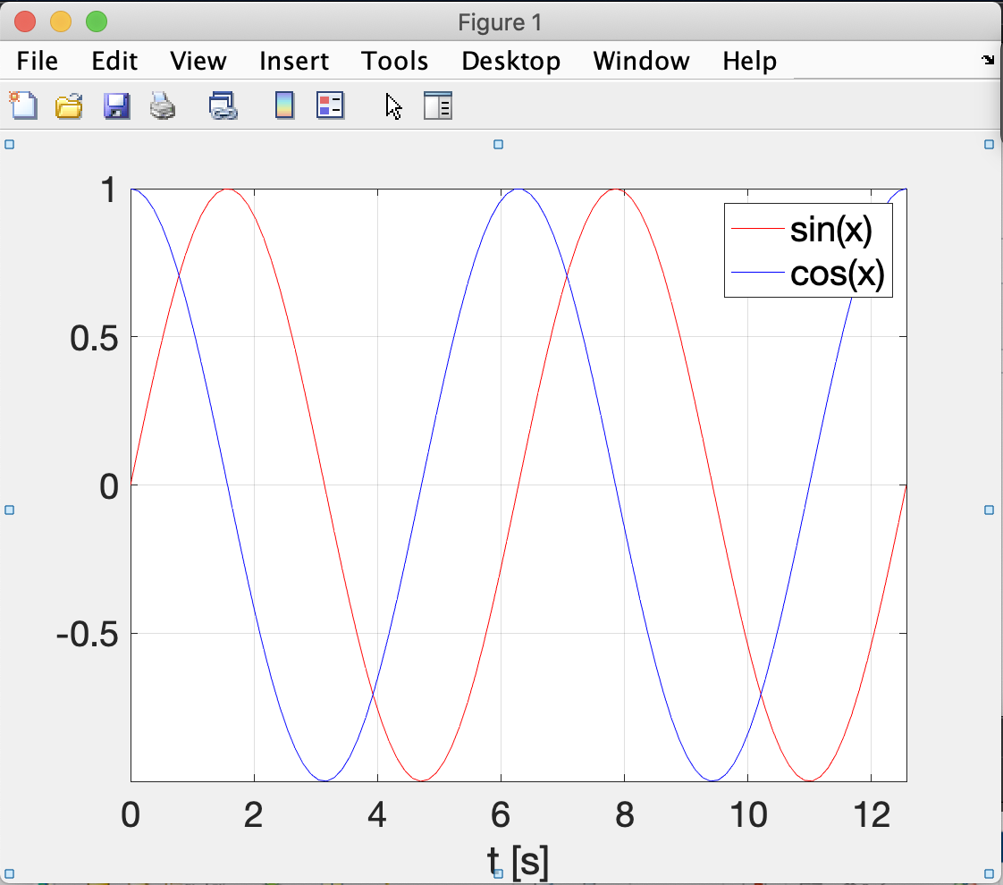
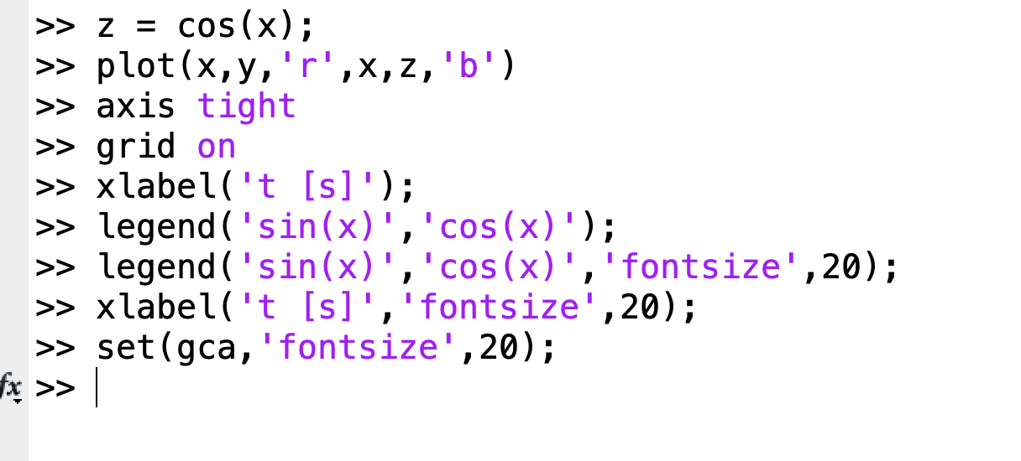
Controlling font size
Fontsize can be changed by adding ‘fontsize’ string and a number
The axes can be edited using set and gca - which references the axes in the currently highlighted figure
Notes:
gca gives the current highlighted figure (axes).
just do gca to change everything bigger (consistent look), but let students know they can play with label/legend separately

Slide 14
Nonlinear scales
In addition to linear scales, data can be plotted on logarithmic and semi-logarithmic scales.
plot both x and y linear
semilogx x logarithmic, y linear
semilogy x linear, y logarithmic
loglog both x and y logarithmic
Notes:
A semi-log plot is a way of visualizing data that are related according to an exponential relationship. One axis is plotted on a logarithmic scale. This kind of plot is useful when one of the variables being plotted covers a large range of values and the other has only a restricted range – the advantage being that it can bring out features in the data that would not easily be seen if both variables had been plotted linearly.
semilogx(Y) creates a plot using a base 10 logarithmic scale for the x-axis and a linear scale for the y-axis

Slide 15
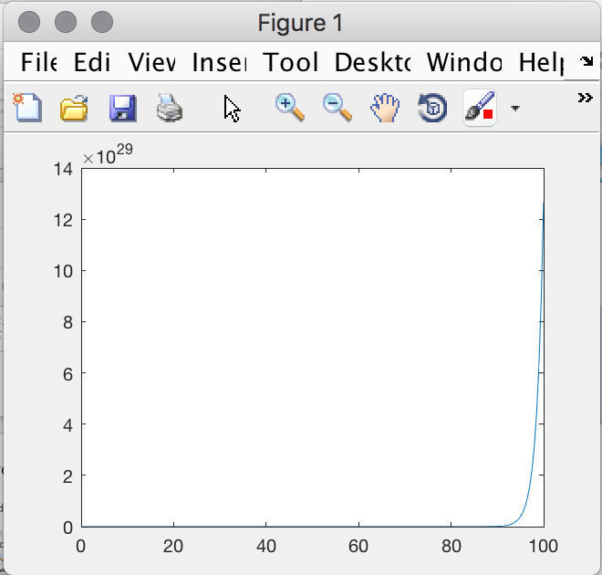
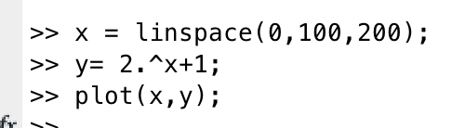
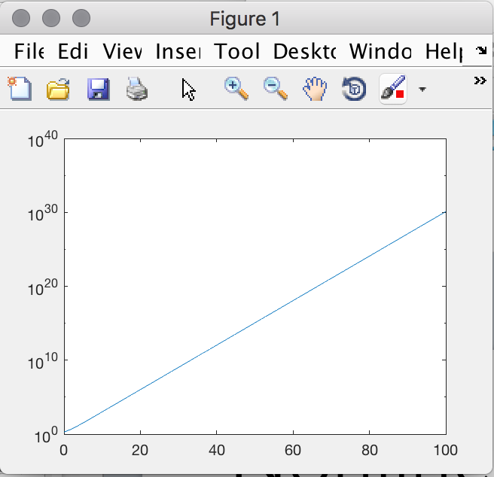
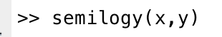
Nonlinear scales (Example)
Also set(gca, 'XScale', ‘log') or set(gca, 'YScale', ‘log’) sets axes logarithmic (or ‘lin’ would make them linear again).
Notes:
Show y in log (otherwise quickly go up when x is large)

Slide 16
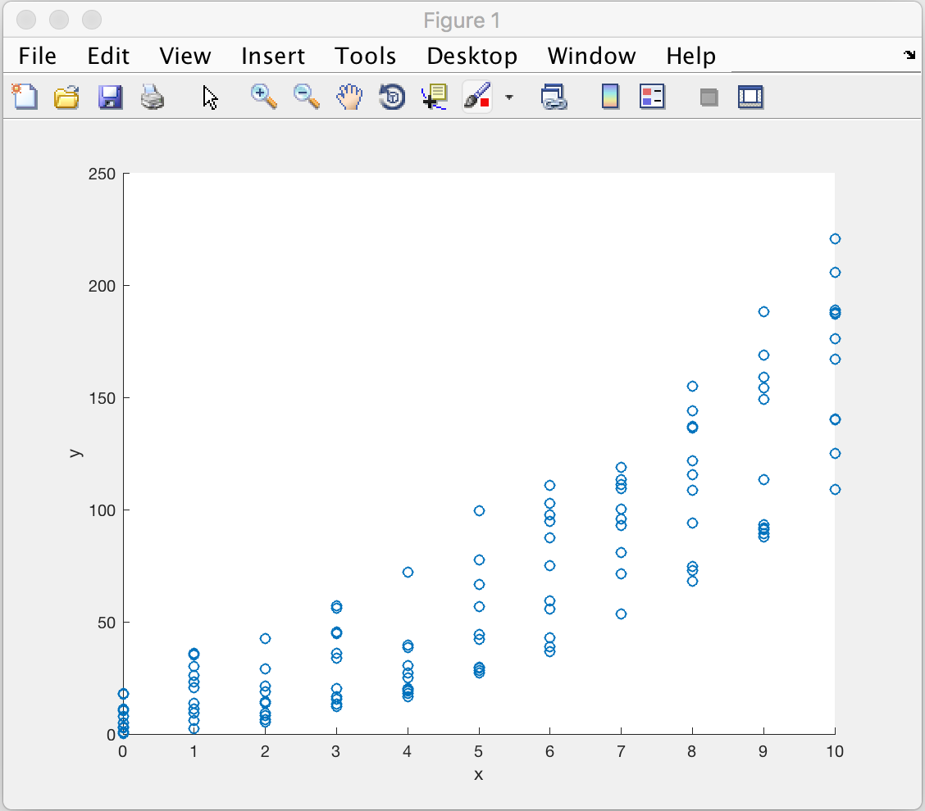
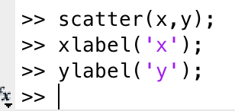
scatter plots
for lists of x and y values that may follow scattered trend (noisy data) can use scatter plot
(can also use plot(x,y,’o’) for same effect - which also allows for log plots)
Notes:
Not a function (mapping): vaccination - side effect at a certain dose could be different
data science or statistics

Slide 17
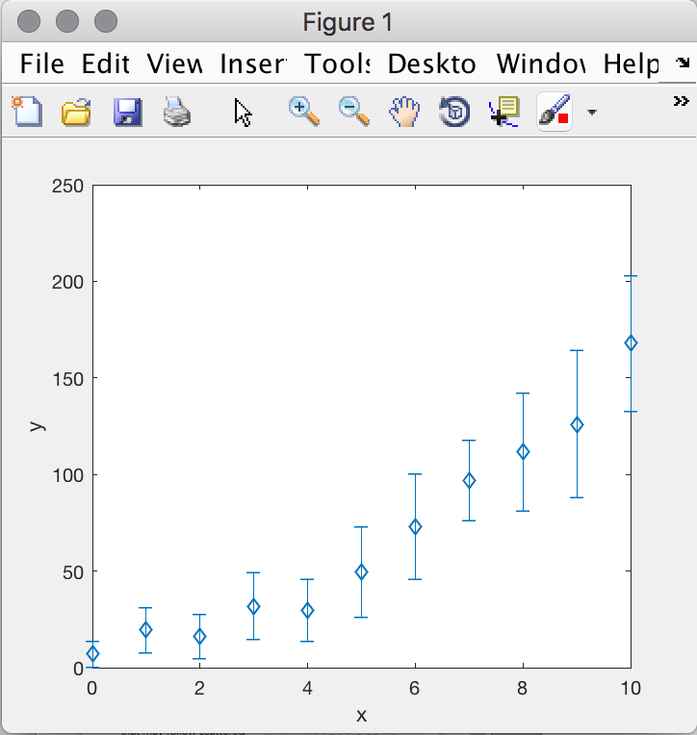
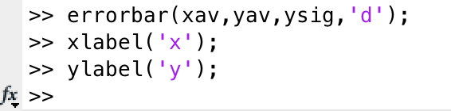
errorbar plot
If we can find e.g. mean(y) and std(y) [std deviation] at each x position, we can do a line plot with error bars:
Notes:
std: sigma = sqrt(sum((x-mean)^2) / N)

Slide 18
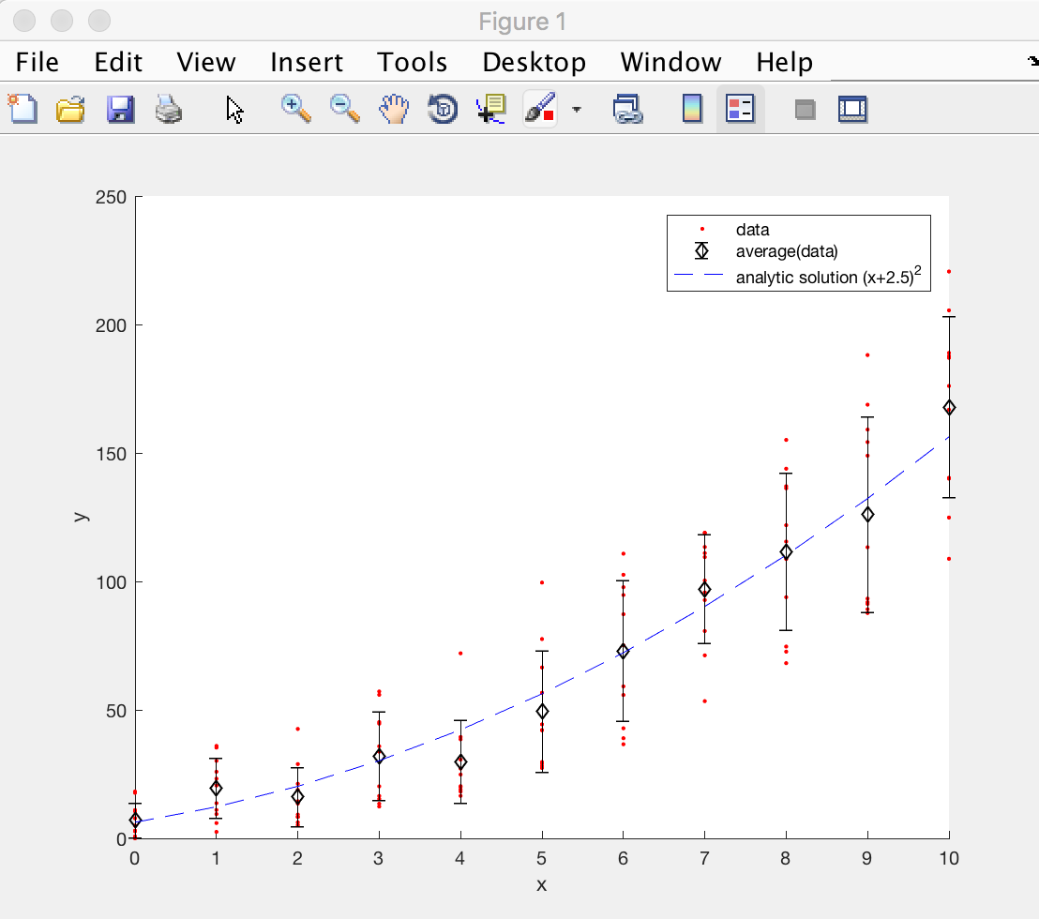
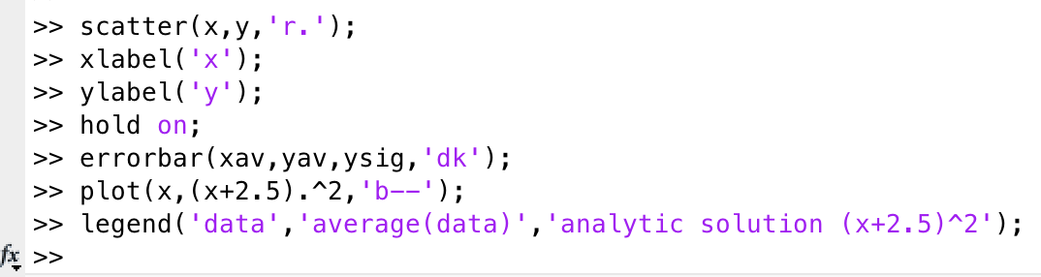
hold
Can combine these plots using hold command - which adds plot to existing plot rather than overwriting:

Slide 19
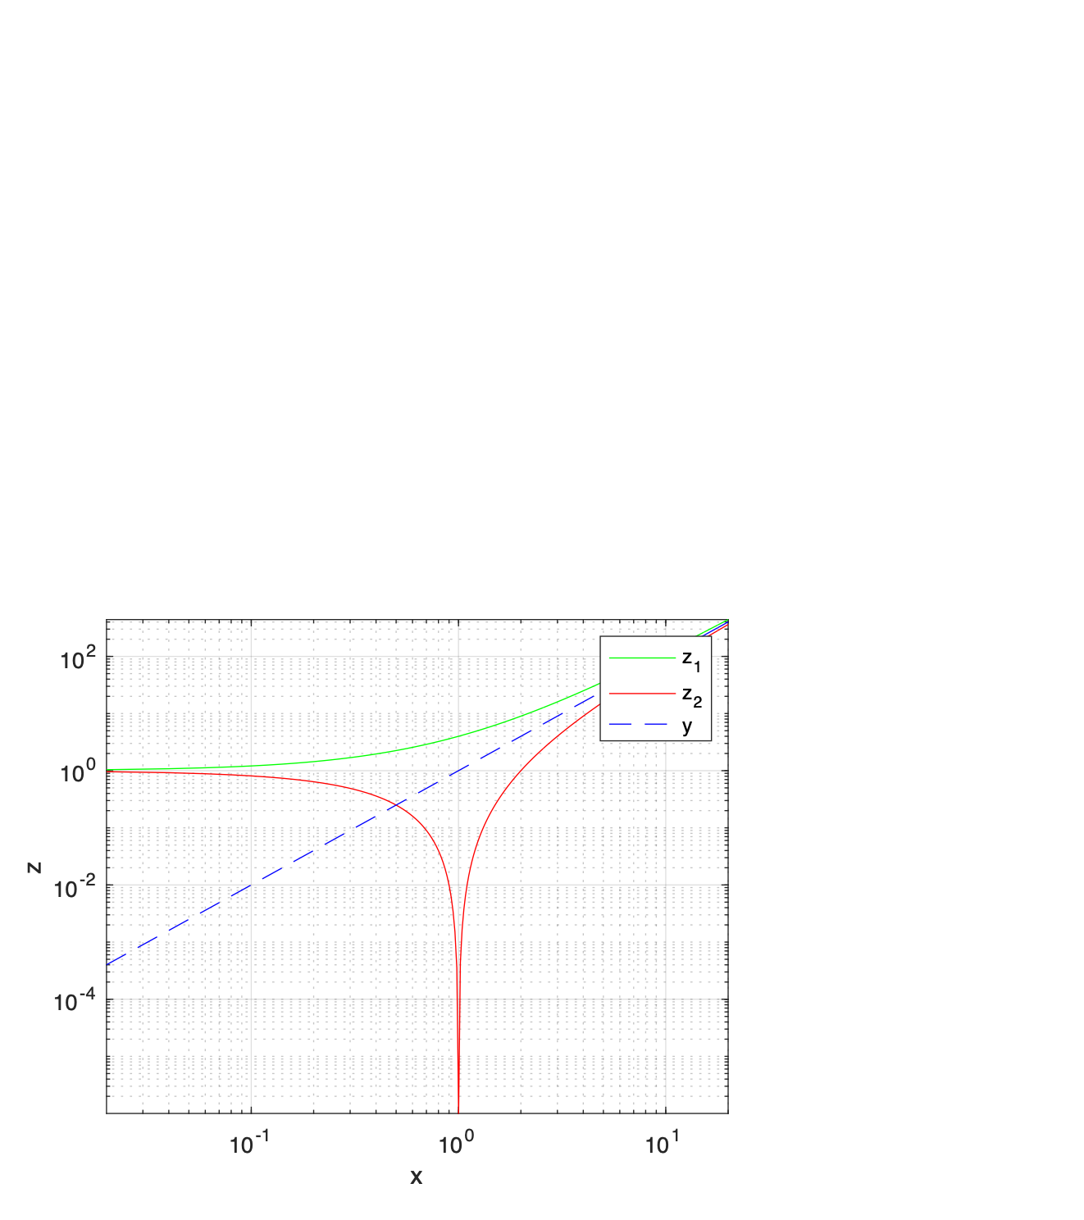
Challenge: multiple plots
Generate the following plot, matching the formatting as closely as possible
For lineSpec, labeling refer to page 11 of this lecture
The functions are defined as follows:
$$z_{1}=(1+x)^{2}$$
$$z_{2}=(1-x)^{2}$$
$$y=x^{2}$$
x is roughly from 0.02 to 20
Notes:
x = linspace(0.02,20,10000);
y = (1+x).^2;
loglog(x,y);
xlim([0.02,20]);
ylim([1e-6,400]);

Slide 20
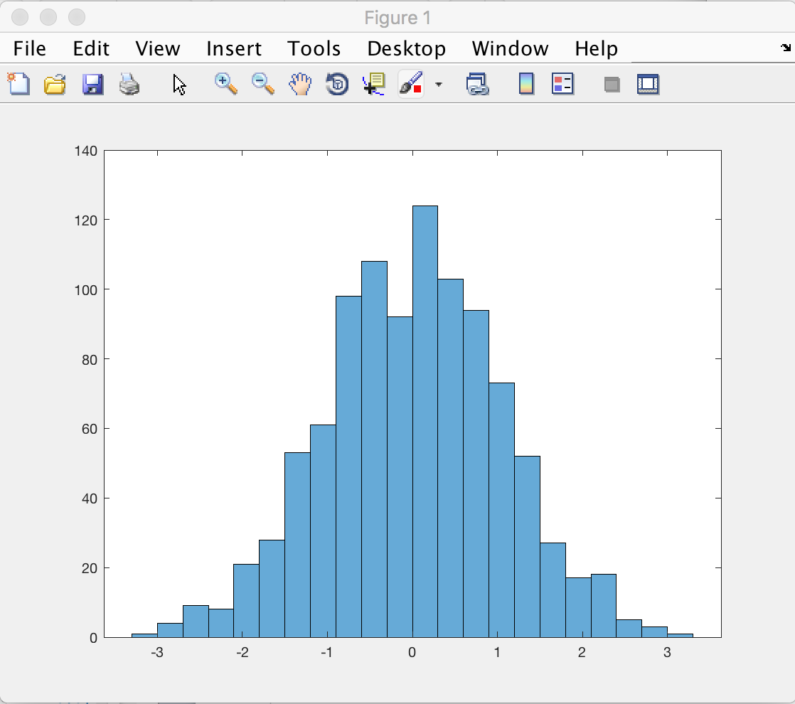
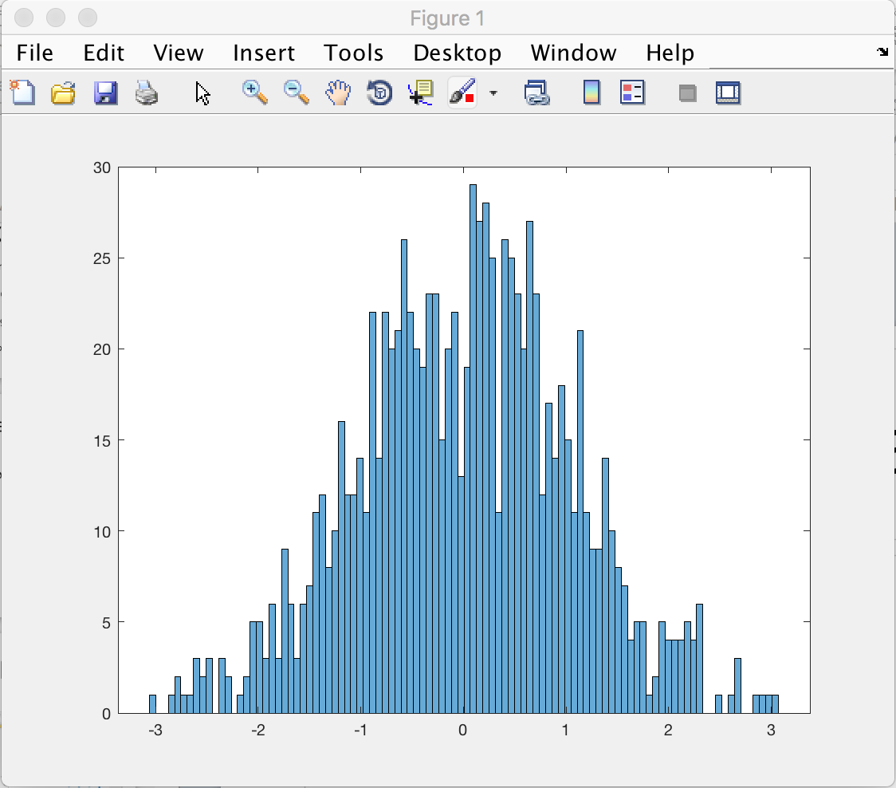
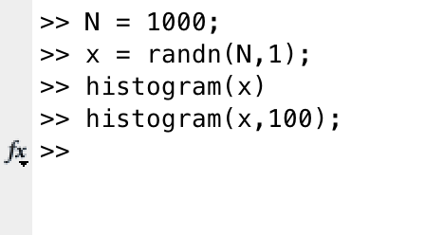
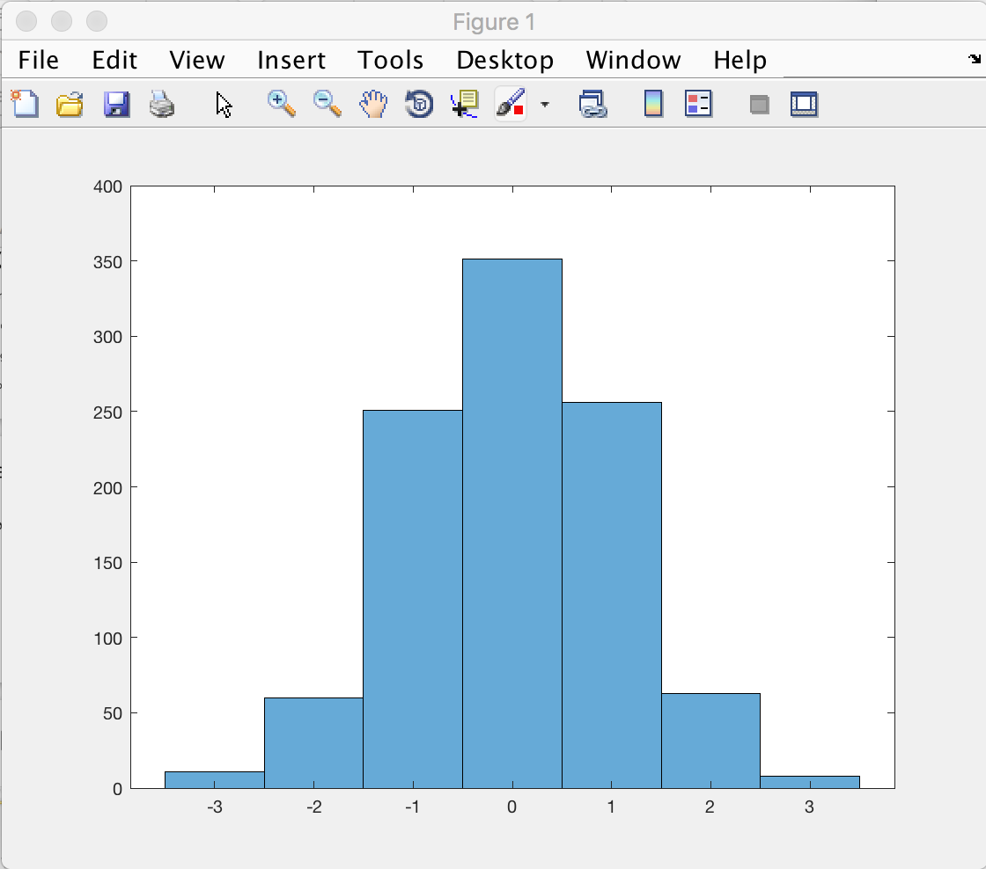
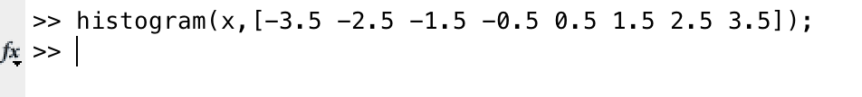
histogram
use histogram to generate binned data plot histogram(X)
histogram(X,nbins)
histogram(X,edges)
Can control how it is binned by specifying number of bins or even directly specifying lower edges of bins:
Notes:
Data set of ages of people
grades of students
histogram(X) uses an automatic binning algorithm that returns bins with a uniform width, chosen to cover the range of elements in X and reveal the underlying shape of the distribution.
X can be a vector, or multiD matrix

Slide 21
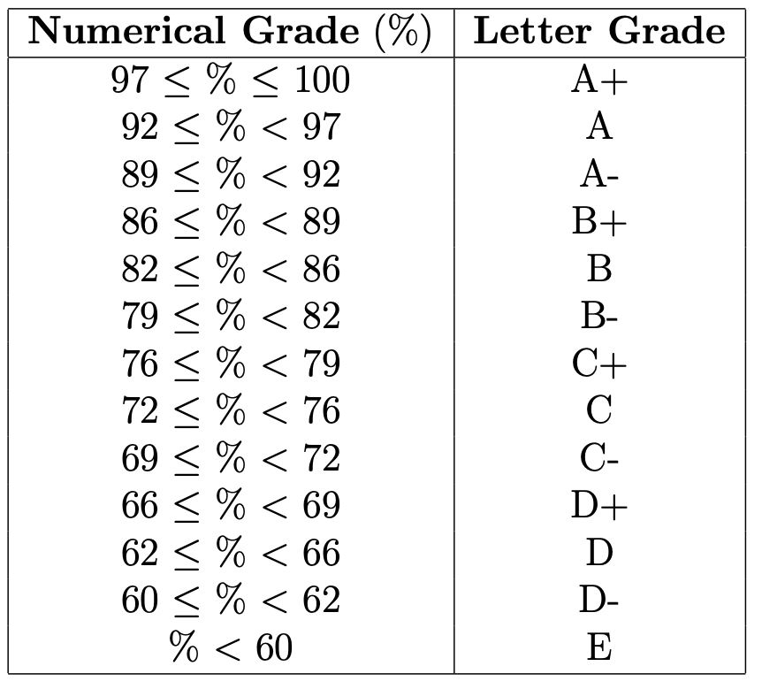
Challenge: Exam grades
In MATLAB - use “load examgrades” to load in built-in example data* - exam scores out of 100. Array has 5 columns - each are results from a different year
Write code to:
Draw a histogram of all the exam grades, with x-axis labelled “score” and y-axis labelled “frequency” with bins corresponding to the grade boundaries:
* or if that doesn’t work, download examgrades.mat from canvas into the directory you are working from and try again
Notes:
histogram(grades);
xlabel(‘scores’)
ylabel(‘frequency’)
12:45?

Slide 22
Contents
Project 1 brief
Data visualization in 1D
Data visualization in 2D
RGB images

Slide 23
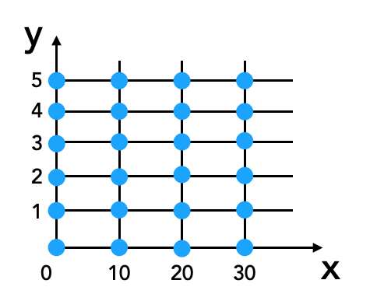
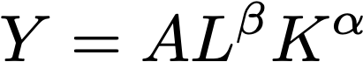
Data as a function of two variables
How to display f(x,y) ?
For example this could be the elevation of terrain as a function of x and y
Example from economics - “Cobb-Douglas production function” - the relationship between the amount of output production Y as a function of labor L (person-hours) and capital K (real value of machinery) inputs, for example
(wikipedia)

Slide 24
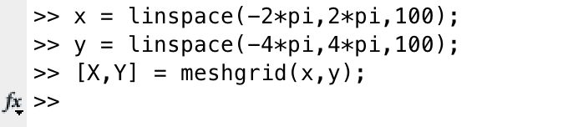
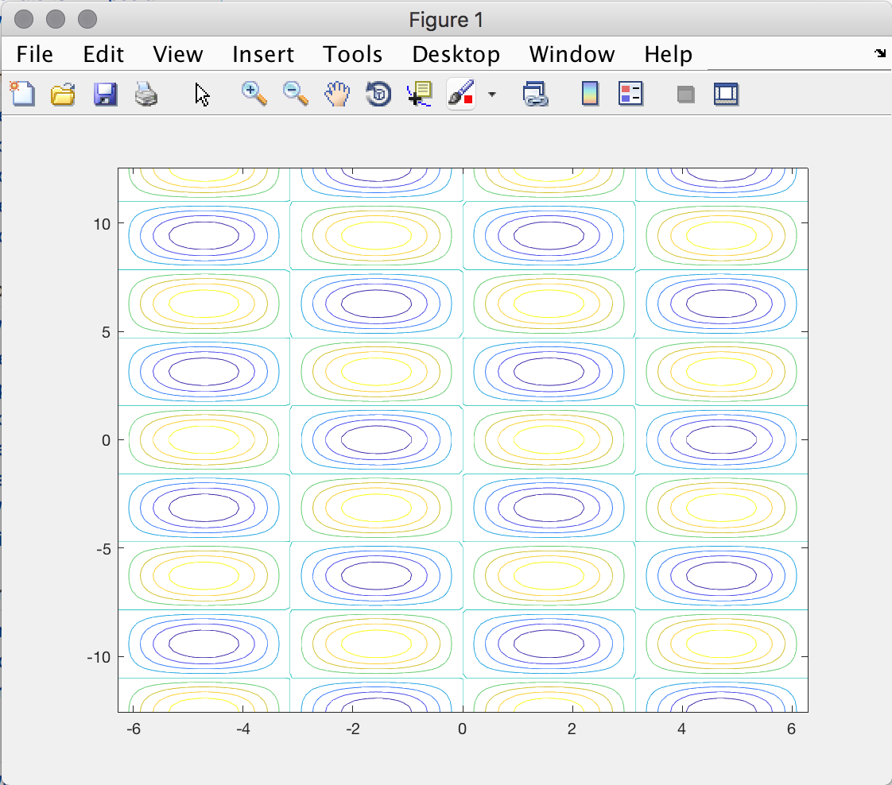
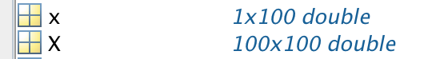
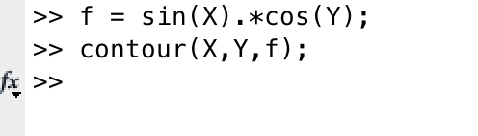
Data as a function of two variables: sin(x)cos(y)
Generate two variables as a grid
Display as contour plot
and now our function f(x,y)

Slide 25
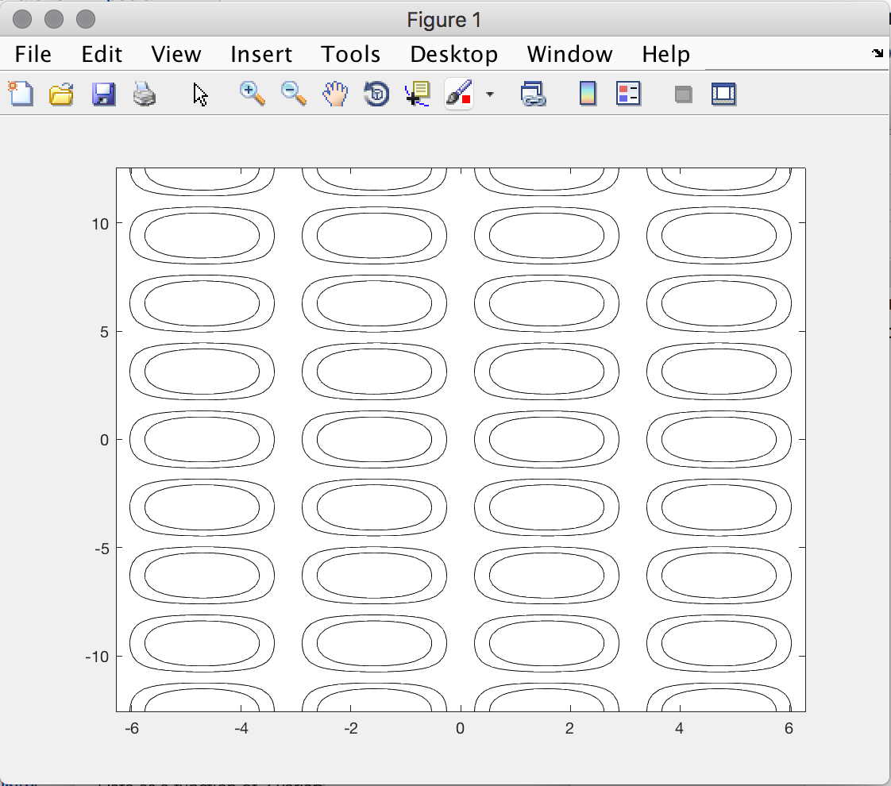
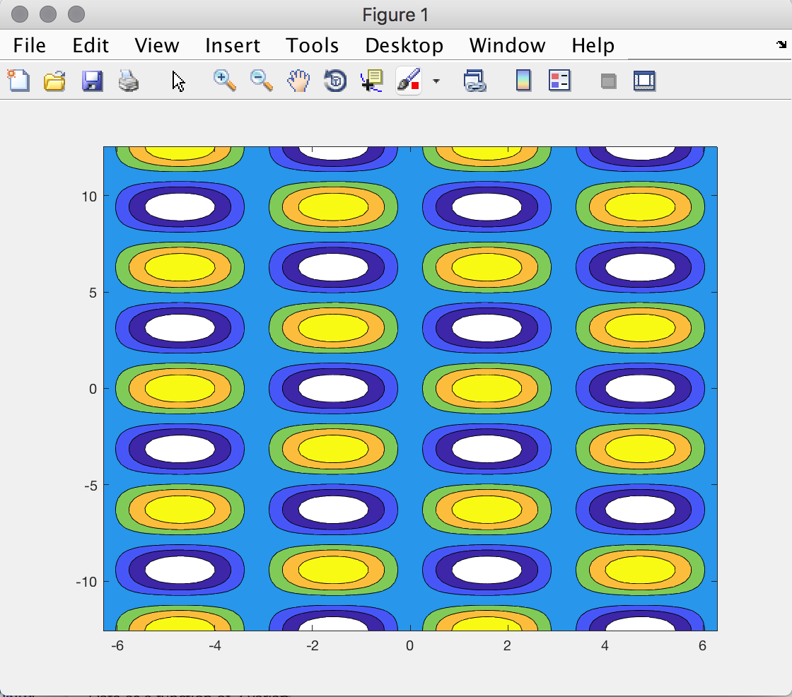
contour plots
Can control contours by defining levels and LineSpecs
Can fill contours with color with contourf
Notes:
contour levels, specified as a scalar number or a vector (draw lines at specific heights)

Slide 26
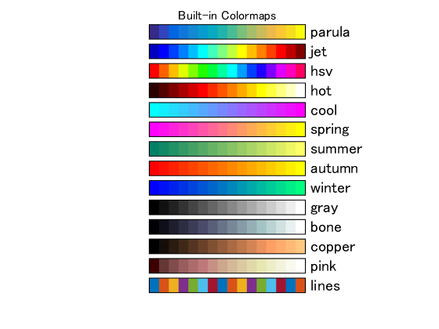
Matlab colormaps
Colormaps translate a numerical value to a color for data visualization

Slide 27
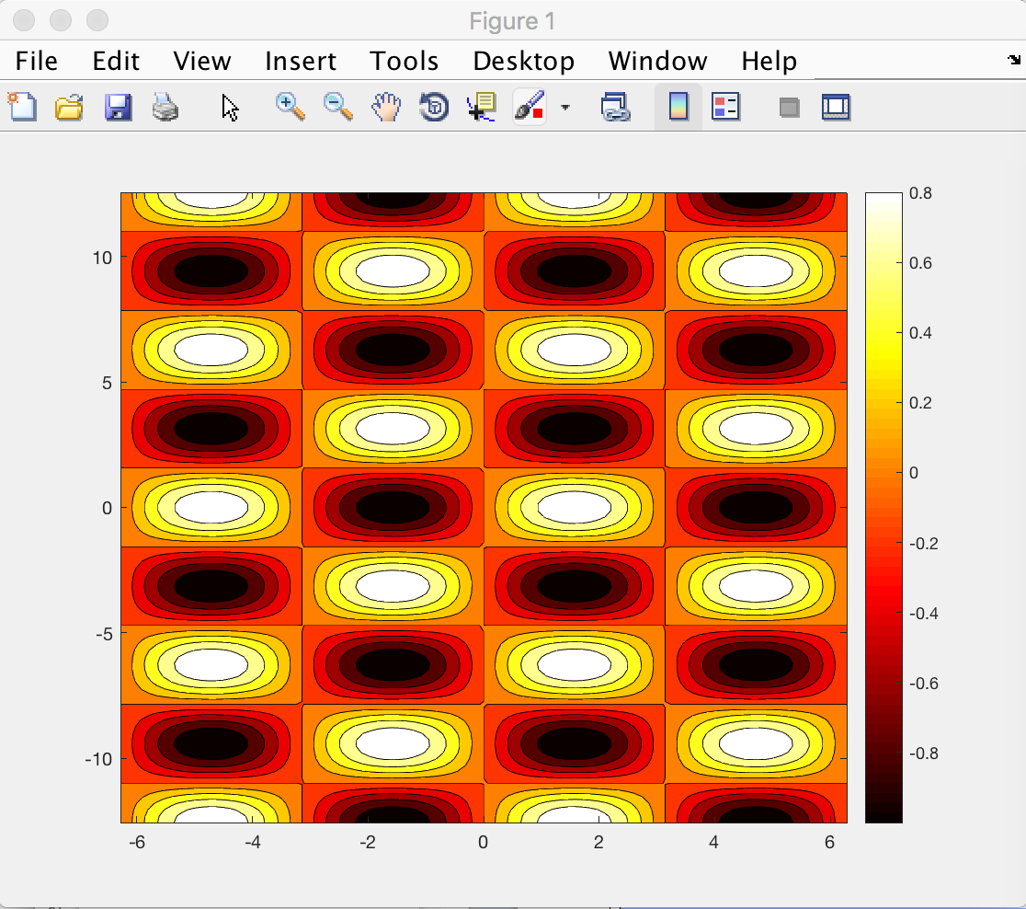
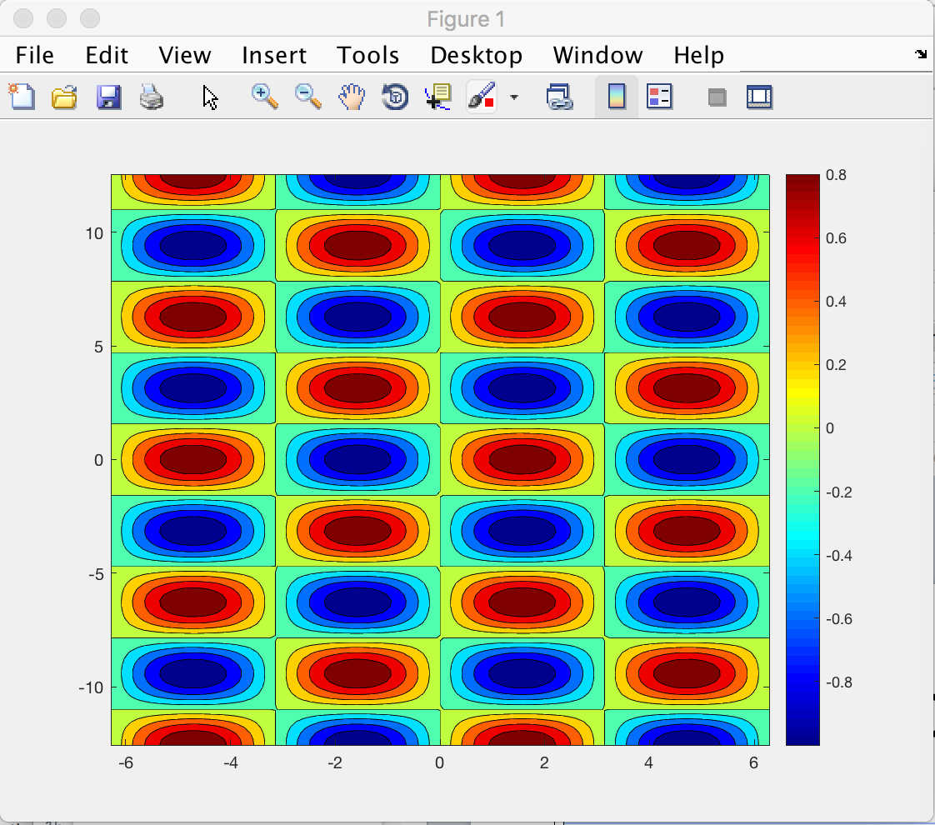
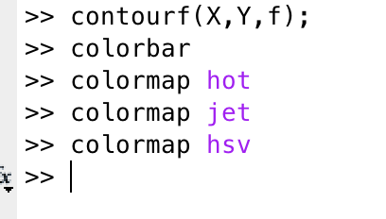
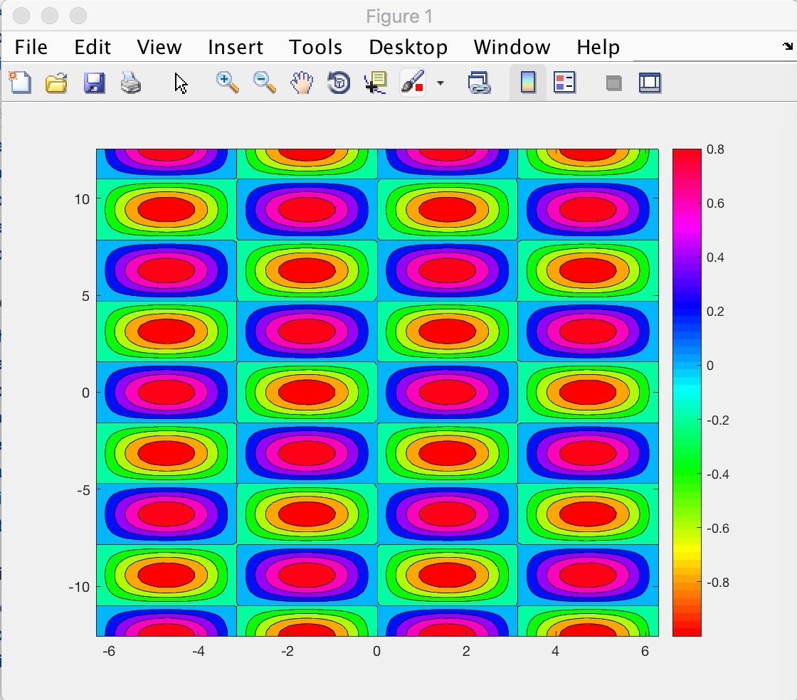
colormaps
for colored plots, colors indicate values via a colormap
colorbar shows the current colormap

Slide 28


image and imagesc will show matrix data as colormap colored image
image(f)
image shows data with values 0-255 represented by color
imagesc is scaled image - colormap is scaled to maximum and minimum values
Since -1 < f <1, Matlab scales it to 0-255 internally by calling
imagesc(f)
image((f+1)*128)

Slide 29


Combining contours and image
…. can be aesthetically pleasing

Slide 30


Surface, mesh, waterfall plots
Can show the same 2D data as quasi-3D plots
if data were terrain height as a function of x,y position, then surface would be physical surface
subplot allows for more than one plot in the same figure
Notes:
subplot(m,n,p) divide the figure into m by n grid and create p’th plot by row

Slide 31

Challenge: surface plot
This exercise combines logical indexing with plotting
Draw a copper bowl!
Hints: x,y from -2 to +2 meshgrid to get X,Y Function is parabolic $f=x^{2}+y^{2}$ colormap copper surf(X,Y,f,’edgecolor’,’none’) is surface plot If you set elements to NaN they won’t show in plot
Notes:
f = X.^2 + Y.^2;
colormap copper;
f(f>4) = NaN;
edge color would give you color on the mesh edge.

Slide 32

Challenge: surface plot
This exercise combines logical indexing with plotting
Draw a copper bowl filled with water!
Hints: water surface given by w = 3 for w > f surf(X,Y,w,'edgecolor','none','facecolor','b'); is surface plot with blue color If you set elements to NaN they won’t show in plot
Notes:
w=3*ones(1000,1000);
w(w<=f) = NaN;
surf(X,Y,w,’edgecolor’,’none’,’facecolor’,’b’);

Slide 33



vector plots
For a vector field, we need to show the direction of the field at all points
Example: magnetic field around a wire

Slide 34


Can show direction using quiver
quiver(x,y,Ax,Ay) displays arrows with length = magnitude of sqrt(Ax^2+Ay^2) and direction Ax,Ay at points x and y

Slide 35


Combine imagesc, contours and quiver…

Slide 36
Contents
Project 1 brief
Data visualization in 1D
Data visualization in 2D
RGB images

Slide 37

RGB images
One way of representing a 2-D image is through 3 matrices representing the red (R), green (G) and blue (B) values
Each matrix represents the intensity of a color for all pixels in a 2-D plane
Importing a jpg file into MATLAB will produce an array of NxMx3 dimensions of type uint8 A = imread(<filename>);
imshow(A) will display image
uint8 is of unsigned integer type, numbers ranging from 0 to 255

Slide 38


Manipulate images by changing array values
Convert RGB -> BGR
Make top half of original image BGR
Remove red from right half of image

Slide 39


Can manipulate images by changing array values

Slide 40
Next lecture
MATLAB: Basic statistics and smoothing, curve fitting, interpolation and the curve fitting toolbox

